Slide 1
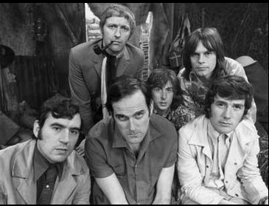
Time Series Analysis with Python
Akhilesh Jain (AJ)
11 July 2018

Slide 2
Outline
Introduction
Decomposing time series
Holt-Winters model
Stationarity and SARIMA

Slide 3
Introduction
A time-series is a set of observations on a quantitative variable collected over time.
Examples
Sales, software downloads
Views on OSIsoft Learning YouTube channel
Incoming calls to TechSupport
Message logs from PI System (?)
Businesses are often very interested in forecasting time series variables.

Slide 4
Methods used in Forecasting
Regression Analysis
Independent variables may not available to build a regression model of a time series variable.
Time Series Analysis (TSA)
A statistical technique that uses time-series data for explaining the past or forecasting future events.
The prediction is a function of time (days, months, years, etc.)
No causal variable; examine past behavior of a variable and attempt to predict future behavior

Slide 5
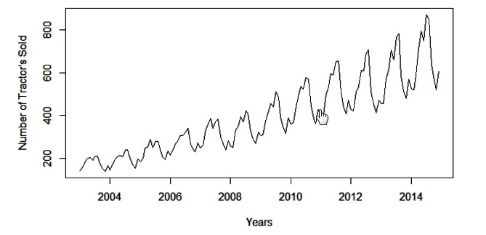
Components time series data
Time Series components are
Level: The average value in the series.
Trend: The increasing or decreasing value in the series.
Seasonality: The repeating short-term cycle (up and down) in the series.
Noise: The random variation in the series
Systematic components: consistent, recurrent and can be described and modeled.
Non-Systematic components: cannot be directly modeled.
Learn more: https://machinelearningmastery.com/decompose-time-series-data-trend-seasonality/

Slide 6
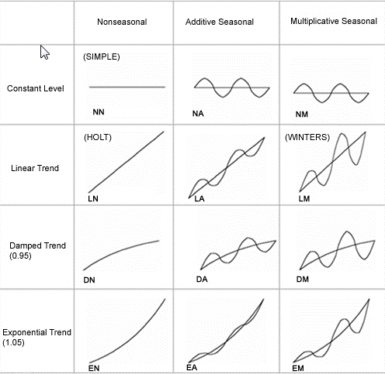

Models for decomposing time series
Additive model
y(t) = Level + Trend + Seasonality + Noise
Multiplicative model
y(t) = Level * Trend * Seasonality * Noise
Pseudo-Additive Decomposition
y(t) = Trend * (Seasonality + Noise - 1)

Slide 7
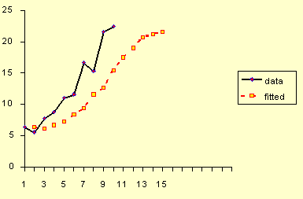
Forecasting
Today is same as yesterday : ŷ_{x+1} = y_{x}
Moving average: ŷ_{x+1} = average of last n values
Exponential smoothing: ŷ x+1 = α yx + (1−α) ŷx−1
Is it though?
What is n?
Equal weight to all values
Exponential smoothing
Exponential comes from the last term
Forecast more than one values?
Trend and seasonality?

Slide 8
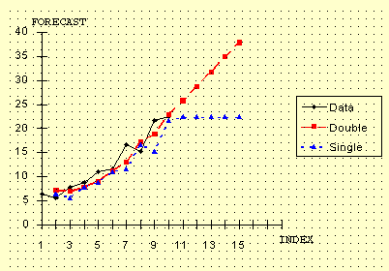
Double Exponential smoothing:
Double Exponential smoothing model:
ℓx = α (yx−sx−L) + (1−α) (ℓx−1+bx−1)
b_{x} = β (ℓ_{x}−ℓ_{x−1}) + (1−β) b_{x−1}
ŷ_{x+1}= ℓ_{x}+b_{x}
Seasonality?
How to determine α and β?
Single vs. double

Slide 9
Triple exponential smoothing a.k.a. Holt-Winters
Calculate level:
Calculate trend:
Calculate seasonal comp:
ℓx = α (yx−sx−L) + (1−α) (ℓx−1+bx−1)
value with seasonality removed
level with trend
Same as second exponential smoothing
Exponential smoothing on Trend
bx = β (ℓx−ℓx−1) + (1−β) bx−1
adjusted level
smoothed over previous trend component
sx = γ (yx−ℓx) + (1−γ) sx−L
Used if seasonality is expected.
Length of the season required
For each observation in the season, there is a separate component; e.g., L = 7 days => 7 seasonal components
value adjusted for level
smoothed over previous values of same season
ŷ_{x+m}= ℓ_{x}+mb_{x}+s_{x−L+1}

Slide 10
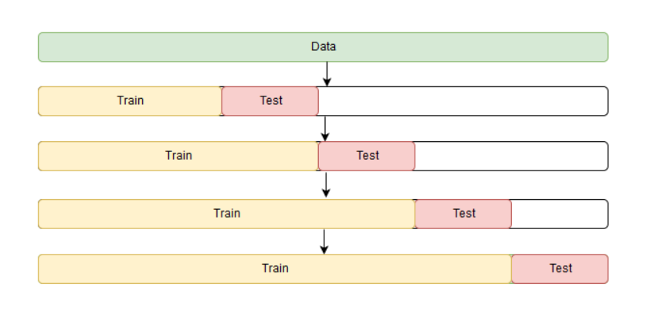
Cross-Validation for time series

Slide 11
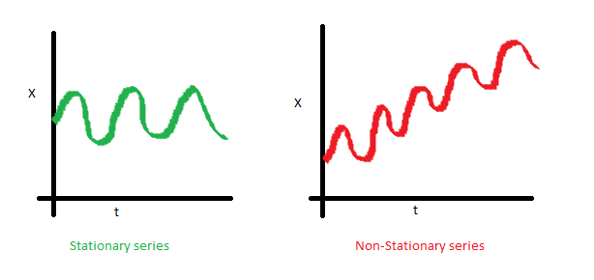
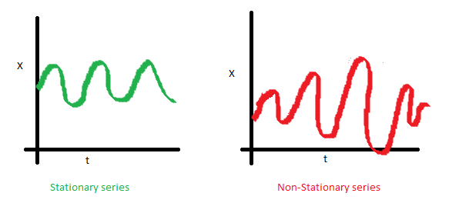
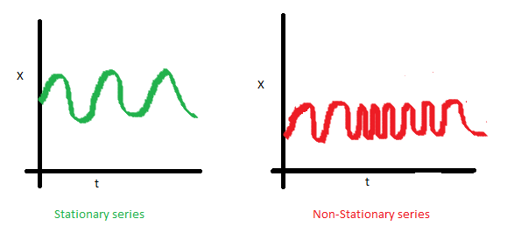
Stationarity
A time series is “stationary” if all of its statistical properties—mean, variance, autocorrelations, etc.—are constant in time. Thus, it has no trend, no heteroscedasticity, and a constant degree of “wiggliness.”

Slide 12
Stationarizing the data
Stationary time series data is like independent variables in regression
By making the data stationary, we can actually apply regression techniques to this time dependent variable.
Transformations to stationarize the data
Logarithmic : Convert multiplicative pattern to additive pattern
First Difference: to stationarize a series with strong trend
Seasonal Difference: to remove gross features of seasonality

Slide 13
Testing stationarity
Augmented Dickey-Fuller Test:
x(t)=ρ*x(t−1)+e(t)
x(t)−x(t−1)=(ρ−1)*x(t−1)+e(t)
for ρ = 1, x(t)−x(t−1)=noise
(Intgrated by order 1)
Null Hypothesis (H0): time series is non-stationary and has a unit root, against
Alternate Hypothesis (H1): time series is stationary and does not have a unit root
The more negative test statistic, the more likely we are to reject the null hypothesis (we have a stationary dataset)

Slide 14
SARIMA
Seasonal AutoRegression (Integrated) Moving Average model
Most general forecasting model
Combines transformations: differencing, logging, deflating etc.
Includes models such as Generalized Random Walk, Exponential Smoothing and Stationarized regression model

Slide 15
SARIMA(p,d,q)x(P,D,Q,s)
AR(p) — Autoregression model - current series values depend on its previous values with some lag (or several lags).
p = Maximum lag in the model from PACF plot
MA(q) — moving average model - current error depends on the previous with some lag
q = Maximum lag in the model from ACF plot
I(d)— order of integration = number of non-seasonal differences needed for making the series stationary.
P = # of seasonal autoregressive terms
D = # of seasonal differences
Q = # of seasonal moving-average terms
s— this letter is responsible for seasonality and equals the season period length of the series

Slide 16
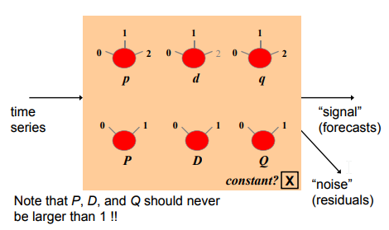
SARIMA(p,d,q)x(P,D,Q,s)

Slide 17
Steps for ARIMA model construction
1. Stationarize the series
2. Study the pattern of autocorrelations and partial autocorrelations
3. Fit the model
4. Check quality metrics

Slide 18

Summary a.k.a. 4 things to remember one week from now
Time Series Components
y(t) = Level + Trend + Seasonality + Noise
Use Triple exponential smoothing a.k.a. Holt-Winters for seasonality
Stationarize your data
S for SARIMA (and Spark)

Slide 19
Useful Resources
Understanding basic concepts behind statistical time series analysis: https://www.itl.nist.gov/div898/handbook/pmc/section4/pmc4.htm
Full notes on statistical forecasting: http://people.duke.edu/~rnau/411home.htm
When to use which forecasting model: http://people.duke.edu/~rnau/whatuse.htm
Good python tutorial on TSA
https://medium.com/open-machine-learning-course/open-machine-learning-course-topic-9-time-series-analysis-in-python-a270cb05e0b3
http://www.seanabu.com/2016/03/22/time-series-seasonal-ARIMA-model-in-python/
Statsmodel library: https://www.statsmodels.org/stable/tsa.html

Slide 20
Monty Python's Flying Circus
When he began implementing Python, Guido van Rossum was also reading the published scripts from “Monty Python’s Flying Circus”, a BBC comedy series from the 1970s.
Van Rossum thought he needed a name that was short, unique, and slightly mysterious, so he decided to call the language Python.

Slide 21
Thank you for attending
Any questions?

